Slide 1
EM Sensor Accuracy
Pavel-Dumitru Cernelev

Slide 2
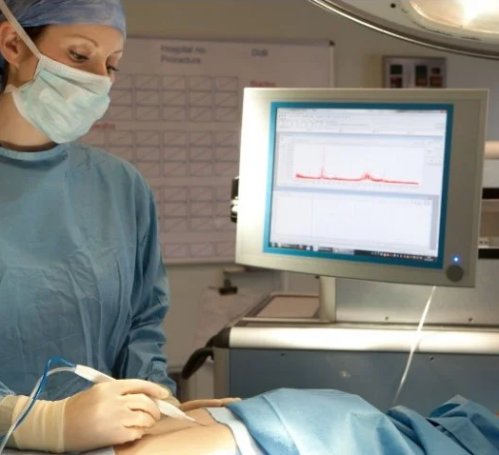
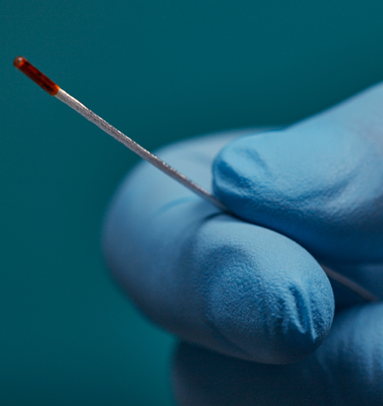
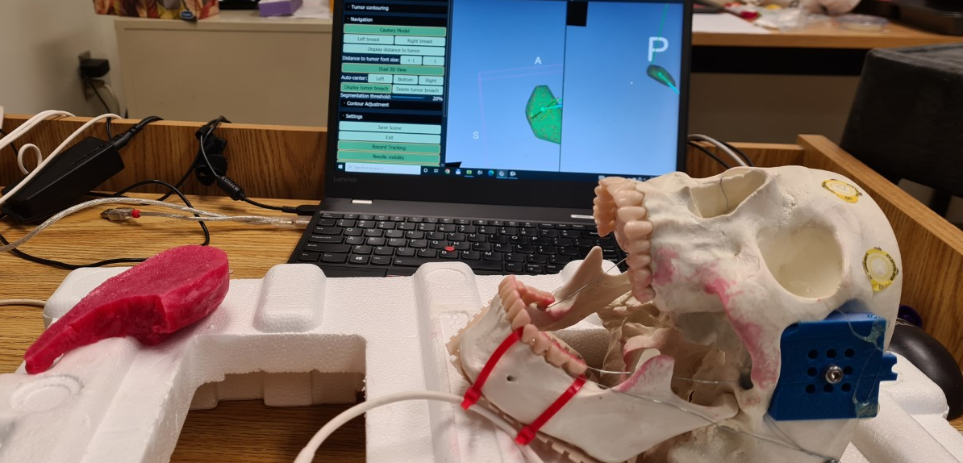
Medical Background
high accuracy and non-invasive
Effective accuracy areas for sensors have yet to be fully understood
In surgery the accuracy must fall below 1mm of error
Notes:
Medical Background:
Currently with the new medical innovations occurring with LumpNav and iKnife, tracking tissues and surgical tools in a non-invasive manner while maintaining high accuracy has become significantly more important.
While smaller sensors are constantly being developed the effective accuracy areas for these sensors have yet to be fully understood.
Pertaining to surgery the accuracy must fall below 1mm of error in a range spanning the operating table to insure viable.

Slide 3
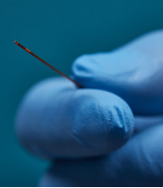
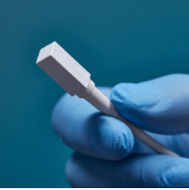
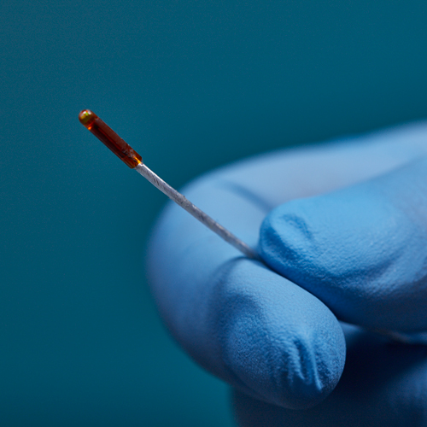
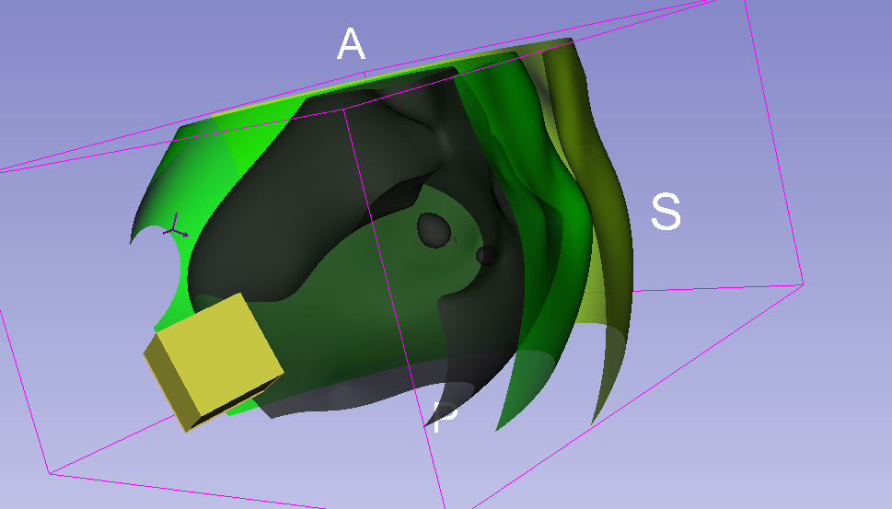
Goal of Experiments
Calculate and find the areas which present below 1-2mm of tracking error
Notes:
The goal of this experiment is to calculate and find the areas which present below 1-2mm of tracking error on an electromagnetically tracked sensor and generate a visualization on a 3D slicer scene.
The sensors used were NDI sensors of sizes 8mm, 2mm and 0.5mm.

Slide 4
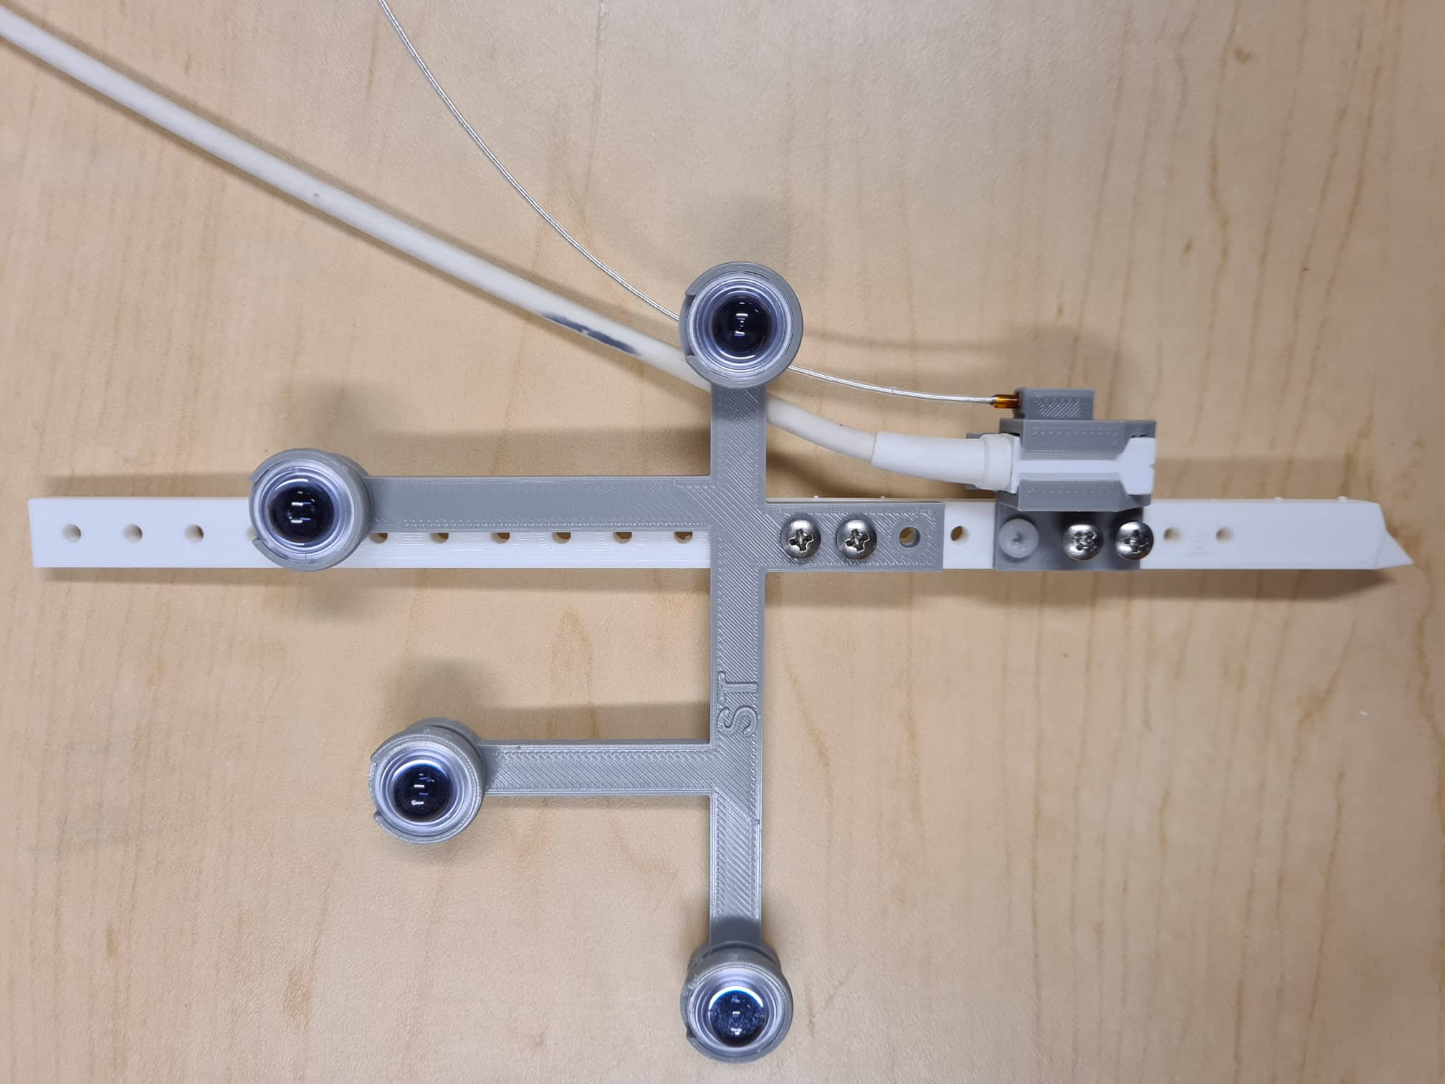
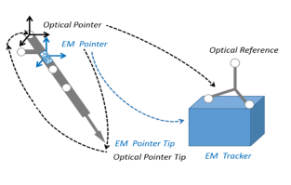
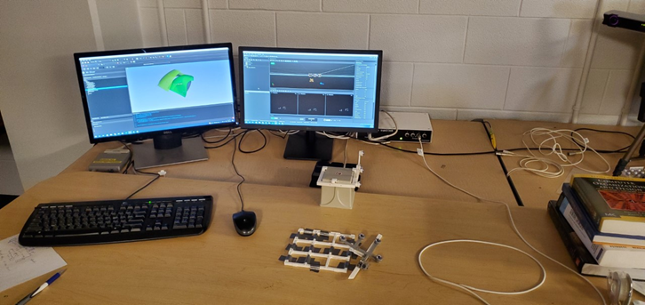
Theory
To calculate the accuracy of the EM sensor
An optical reference is placed on the EM transmitter
After a collection of EM sensor and Optical sensor point
Notes:
Theory:
To calculate the accuracy of the EM sensor an optical sensor and an EM sensor are attached together on a stylus. The optical sensor is highly accurate when in the view of the optical tracking camera, because of this the Optical tracking is used as a ground truth. Therefor, the calculation of the difference in the EM sensor and the Optical sensor results in EM sensor error.
An optical reference is placed on the EM transmitter to
After a collection of EM sensor and Optical sensor points in a 3d grid a B-spline transform can be generated and visualized.

Slide 5
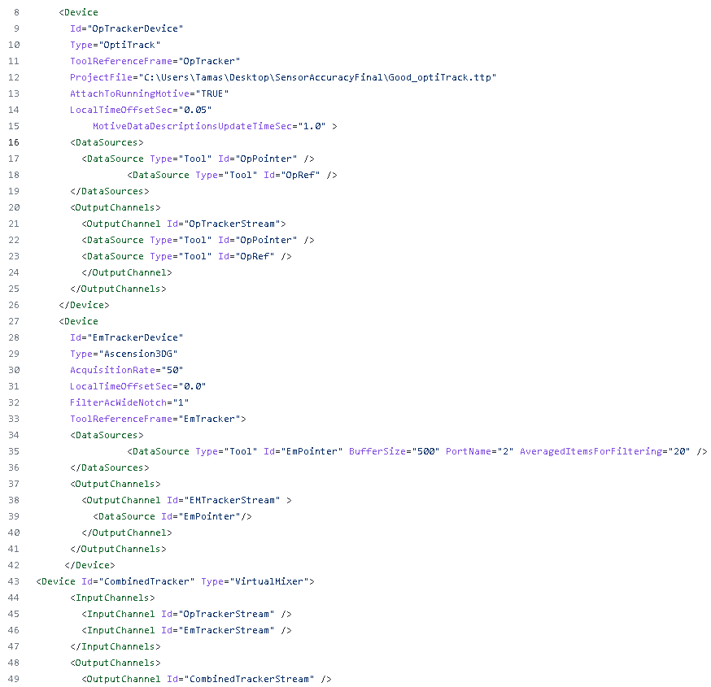
PLUS Server
3D Slicer
PLUS
Hardware (tracker and/or image scanner )
→
→
→
→
EM Tracked through Ascension 300
Optical Tracked through OptiTrack
A virtual mixer is used to combine both tracking signals
Notes:
The PLUS Server is used a mediator for data acquisition allowing for hardware signals to be sent to 3D Slicer.
Because for this experiment the there are 2 types of tracker signals being sent to 3D Slicer the PLUS config file must be configured to allow for both signals to be properly tracked.
A virtual mixer is then used to combine both tracking signals.

Slide 6
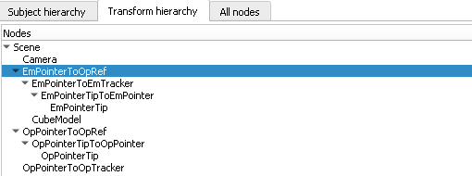
Pivot Calibration
Activated when PLUS server config file has configured
Models are created to represent the point tip of the stylus
Organized in the transform hierarchy
Point tip for EM and OP tracked are then pivot calibrated
>
>
>
Notes:
Once the PLUS server config file has been configured the OpenIGTLinkIF in 3D slicer can be started and activated.
Models are created to represent the point tip of the stylus are then organized in the Transform hierarchy.
The point tips for the EM tracked and OP tracked are then pivot calibrated

Slide 7
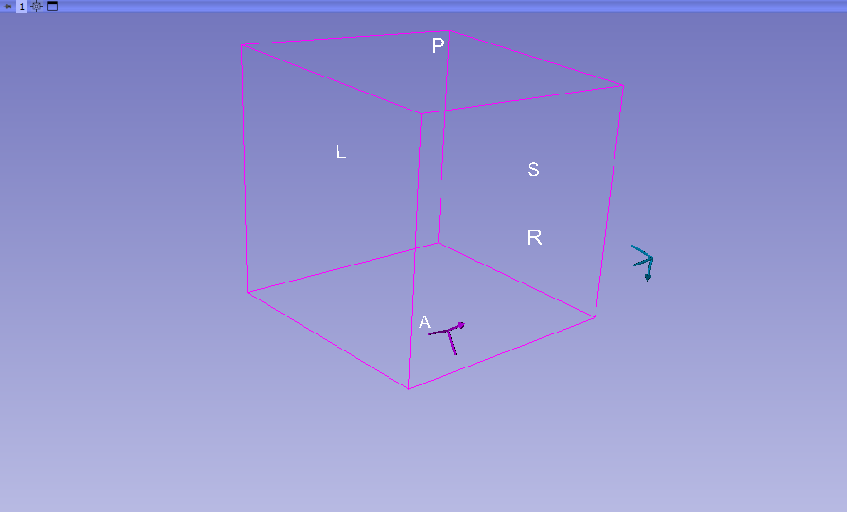
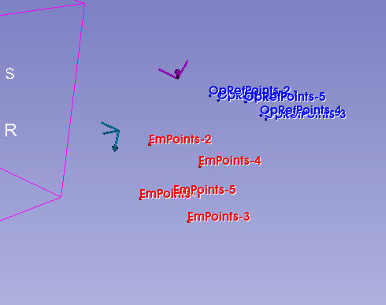
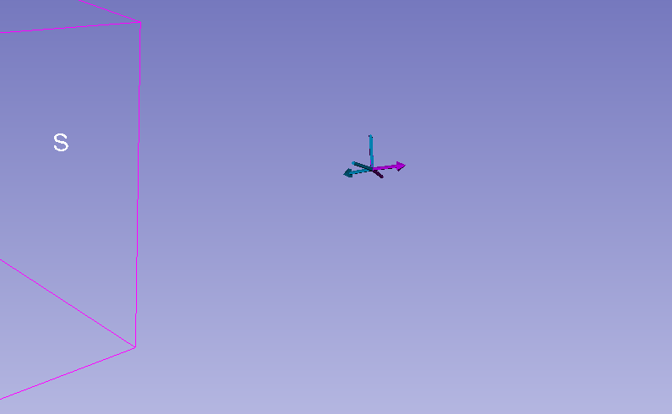
Transformation Generation
Once EM and Optical sensors are calibrated to the stylus tip there is still a problem of them having different references.
The Fiducial Registration Wizard can be used to overcome this issue by creating a transformation between the EM tracker and the optical reference.
Points of the EM and Optical tip are collected and a transformation of EmTrackerToOpRef is created.
>
>
Notes:
Once both EM and Optical sensors are calibrated to the stylus tip. There is still a problem of them having different references therefor the stylus tips in 3D Slicer are not overlapped.
The Fiducial Registration Wizard can be used to overcome this issue by creating a transformation between the EM tracker and the optical reference.
Points of the EM tip and the Optical tip are collected and a transformation of EmTrackerToOpRef is created
Another reorganization of the hierarchy is done and the stylus tips are now overlapping

Slide 8
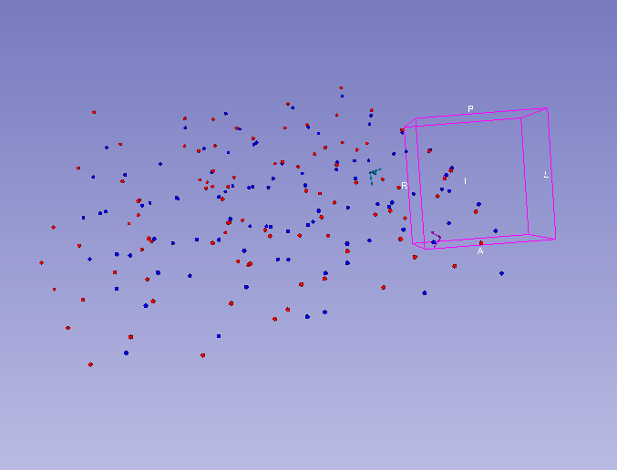

Point Collection
50cm by 50cm range by 20 cm high
Notes:
Now the points can be collected.
We used a 50cm by 50cm range by 20 cm high. This is roughly the dimensions used in the OR. So it is important that if these sensors are used they should satisfy the measurements used in the OR.

Slide 9
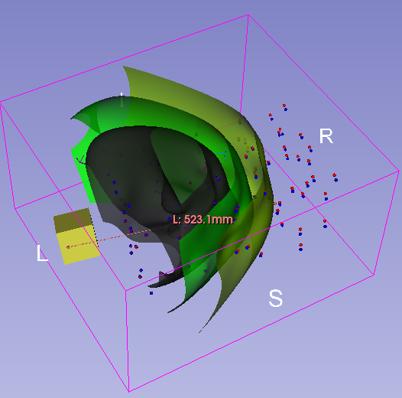
Error Visualization Generation
When the point collection is done a B Spline Transform is done.
This transform can be contoured to generate a heat map in the slicer scene.
Black represents below 1mm of error.
Green 2mm of error.
Yellow is bellow 4 mm of error.
Notes:
Once the point collection is done a B Spline Transform is done on between the EM point and the optical tracked points. This transform can then be contoured to generate a heat map in the slicer scene.
The black represents below 1mm of error, green 2mm of error and yellow is bellow 4 mm of error.

Slide 10
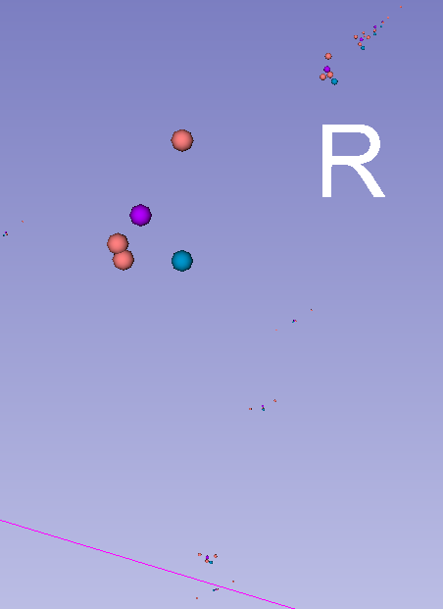
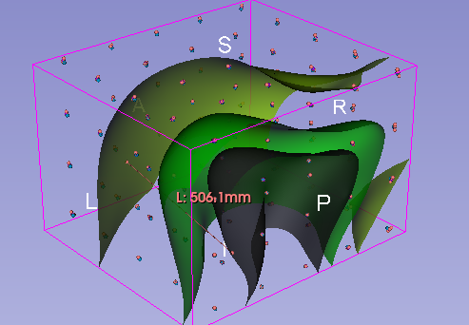

Averaging Multiple Warped Transform Matrices
Pink points are transformed points. Blue point is the origin points. Purple is average points.

Slide 11
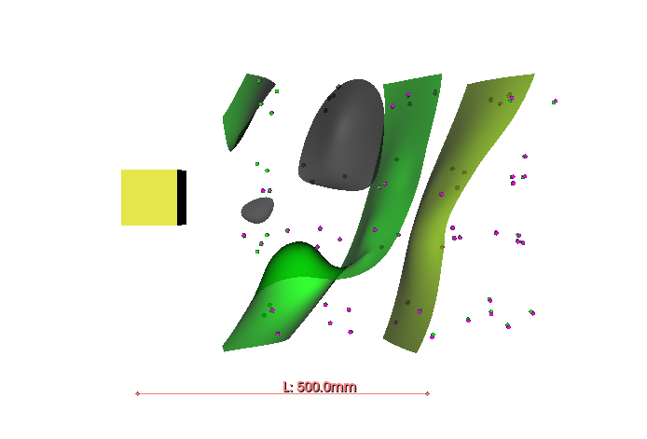
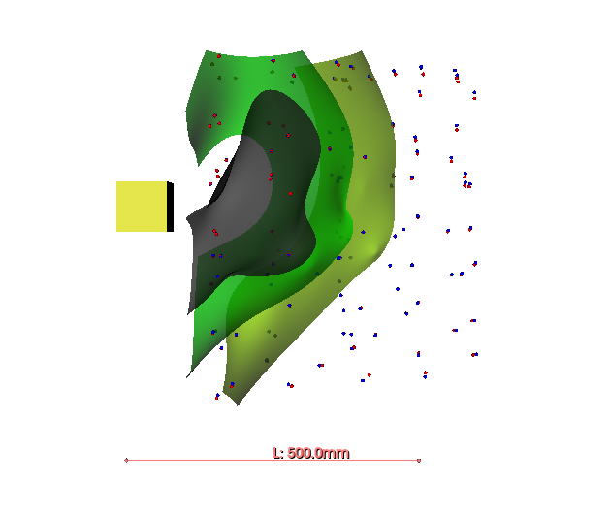
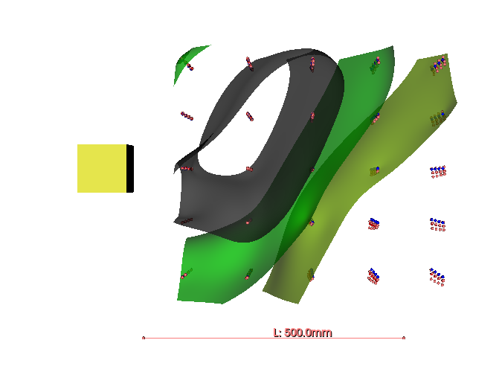
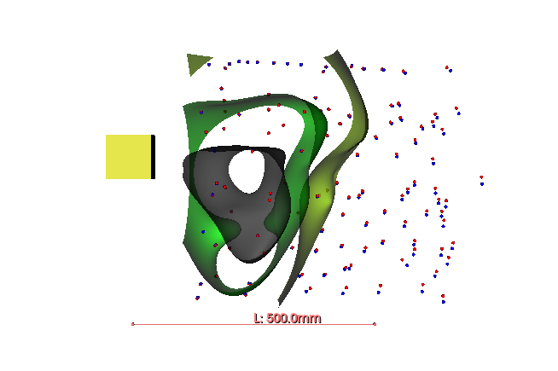
Results: 8mm
The 8mm sensor and the 2mm sensor had similar results on in the
Average Contour
Notes:
Results 8mm:
From the images it can be seen that the EM tracker is functional in the 50cm distance.

Slide 12
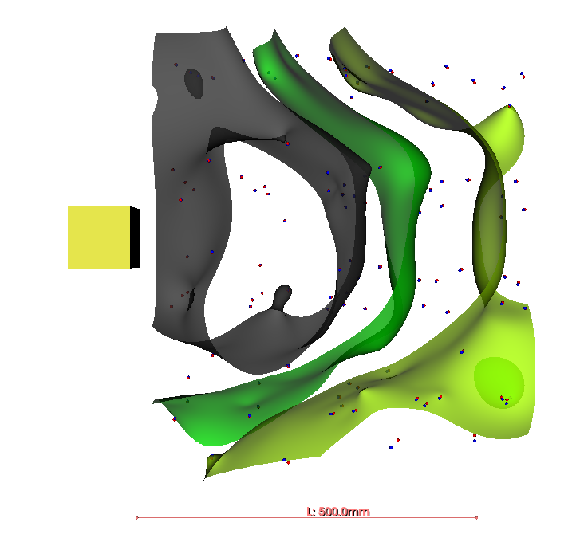
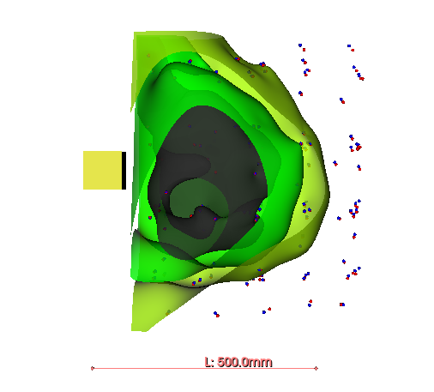
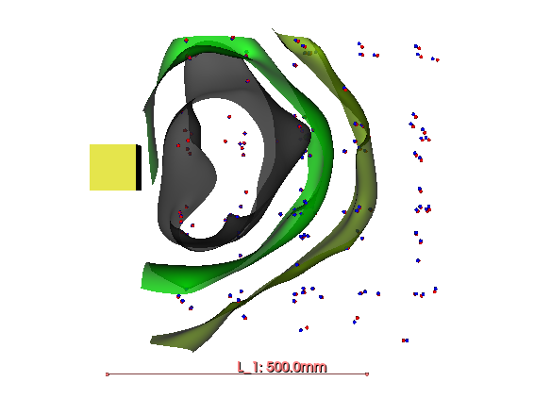
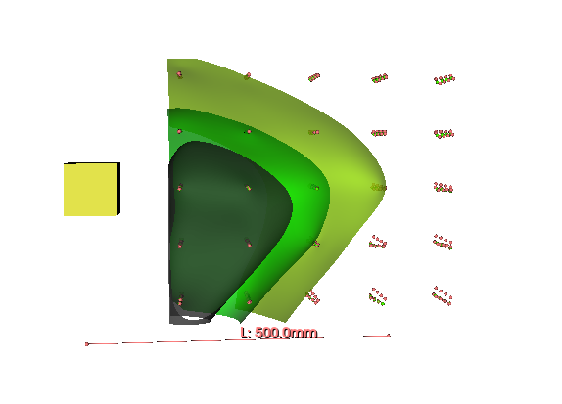
Results: 2mm
Average Contour

Slide 13
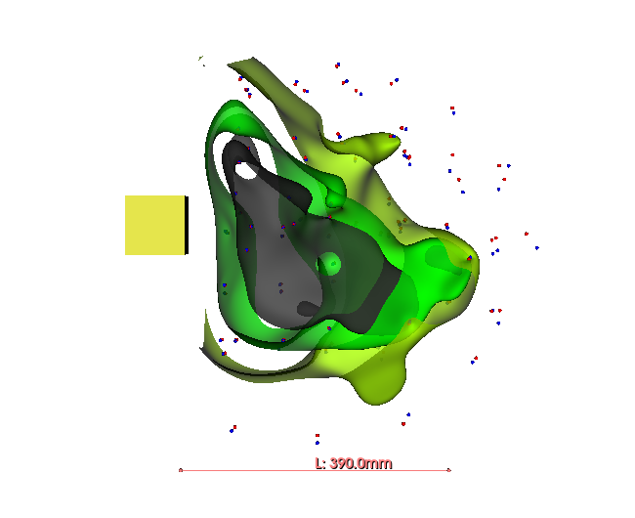
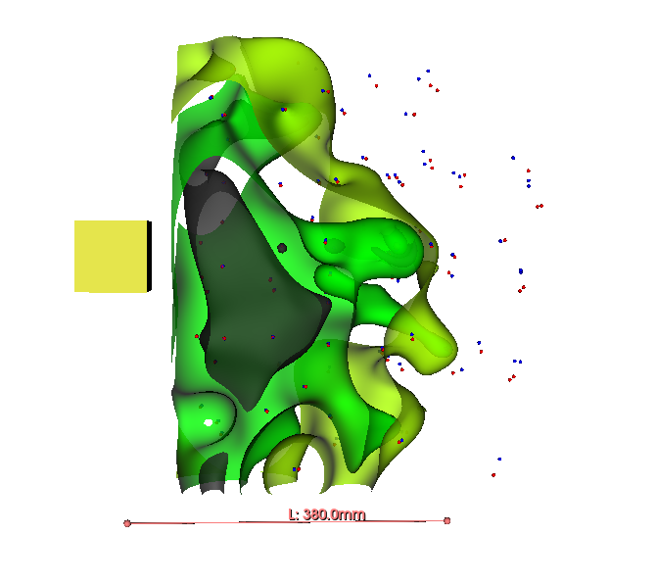
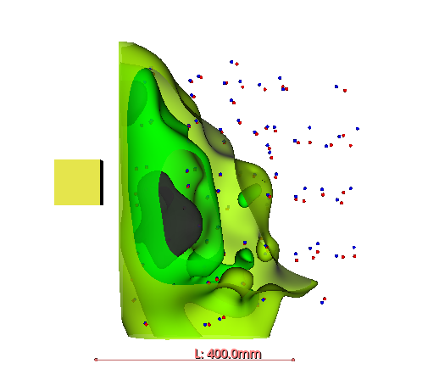
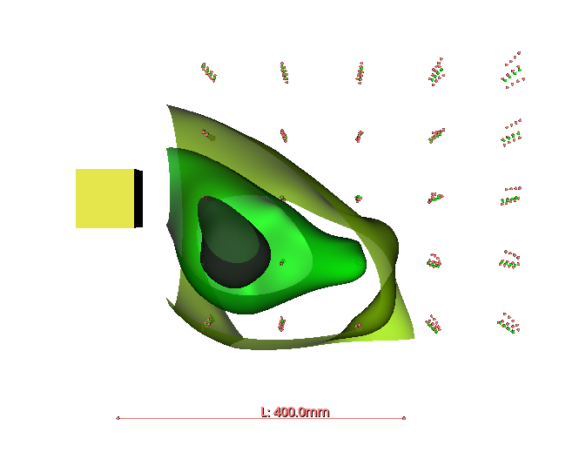
Results: 0.5mm
Average Contour
Notes:
Sensor 0.5:
Highly inaccurate when more than 10cm away from the emitter.
Will not properly get a signal.
Very little area for lower than 1,2 and 4 mm of error.

Slide 14
Application For Future
Title
Title
Title
Title
Title
Tjklafjkl;jkl;asjfkdla;fffdffdfj
Tjklafjkl;jkl;asjfkdla;fffdffdfj
Tjklafjkl;jkl;asjfkdla;fffdffdfj
Tjklafjkl;jkl;asjfkdla;fffdffdfj
Tjklafjkl;jkl;asjfkdla;fffdffdfj
Notes:
Application for Future:
This method for EM tracking error can be used to test the compatibility of surgical tools with EM sensors.

Slide 15
Questions

